Slide 1

LEARN
BROGRAMMING
THE HARD
WAY
ROB CHAD SPECTRE
@dN0t

Slide 2
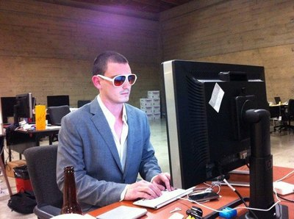
GET WITH THE
BROGRAM

Slide 3

MAKING BROGRAMMERS
SINCE BEFORE YOUR MOM

Slide 4
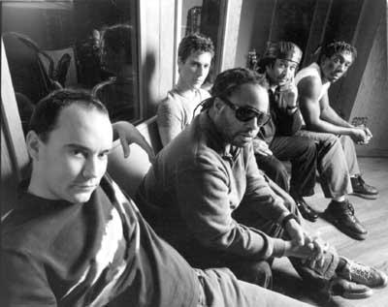
DON'T ACT LIKE
YOU'RE NOT IMPRESSED

Slide 5
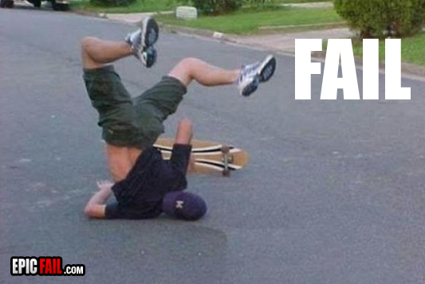
SOME DUDES
CAN'T HANG

Slide 6
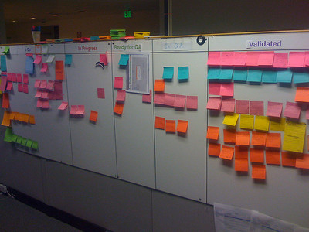
COOL STORY
BRO

Slide 7

JERSEY.
YUP.

Slide 8
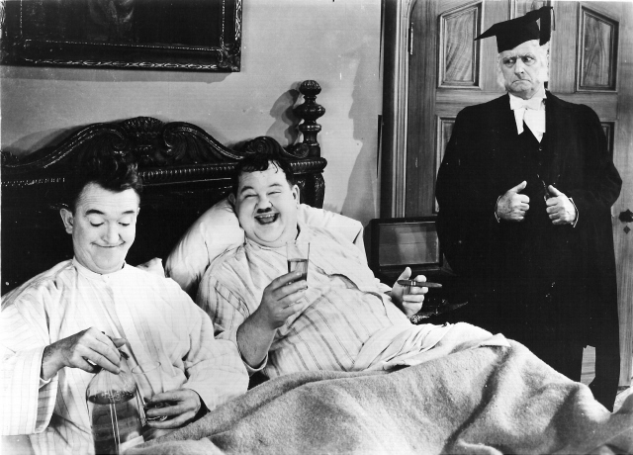
LOW LEVEL CODE
IS FOR CHUMPS

Slide 9
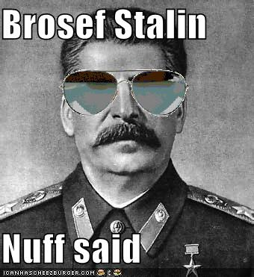
DICTATOR OF THE
BROLETARIAT

Slide 10

WATCH AND LEARN
SCRUBS

Slide 11

THE BROTOCOL:
GROK, TRUNK, LEARN

Slide 12
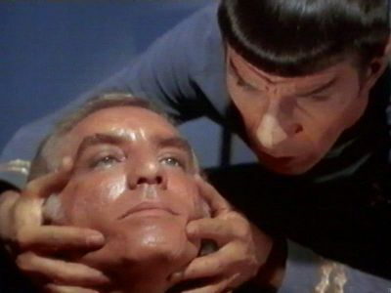
GROK IS NOT
WHAT YOU THINK IT IS

Slide 13
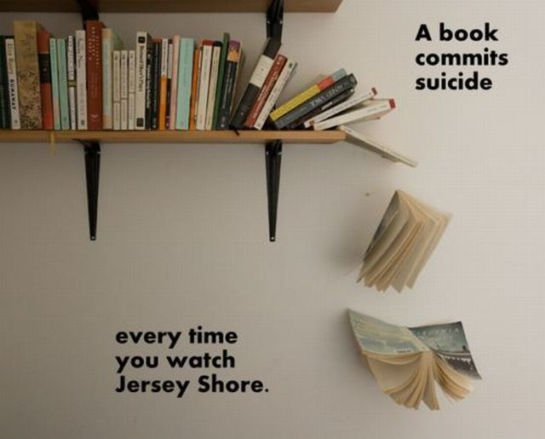
BOOKS ARE
PRETTY SWEET

Slide 14
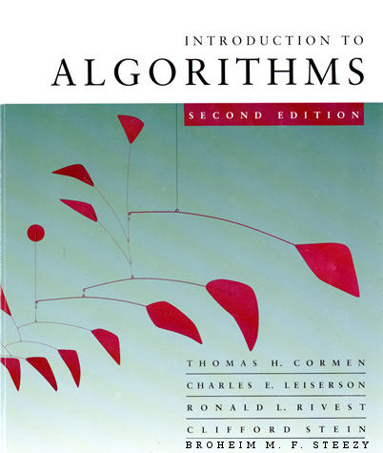
CLRSS
NEW ED WITH BMF STEEZY

Slide 15

THE PRAGMATIC
BROGRAMMER

Slide 16

RESACTORING
FIXING YOUR GRUNGE, BRO

Slide 17
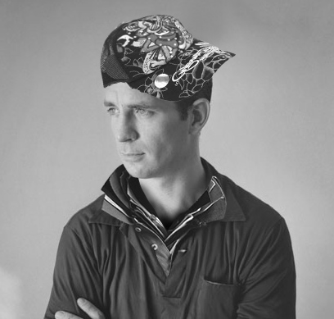
ON THE BRO'D
JACK KEROUAC

Slide 18

PROBIE DICK
HERMAN MELVILLE

Slide 19

MY LIFE
BILL CLINTON

Slide 20
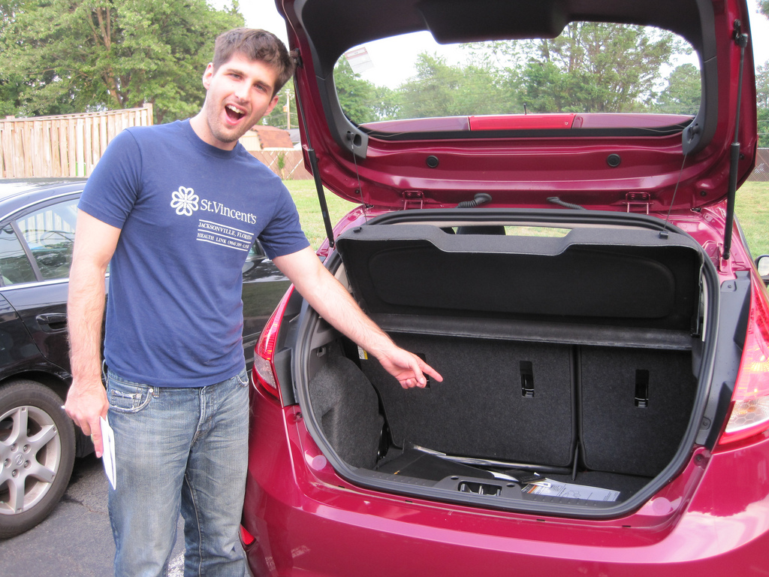
THIS BRO CAN FIT JUNK
IN HIS TRUNK

Slide 21
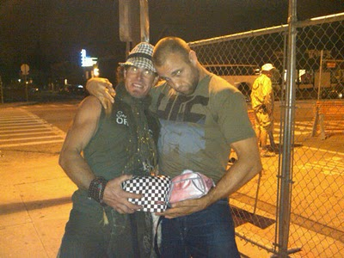
EPIC
UTILITY BELTS

Slide 22

PUTTING THE MAN
BACK IN MVC

Slide 23
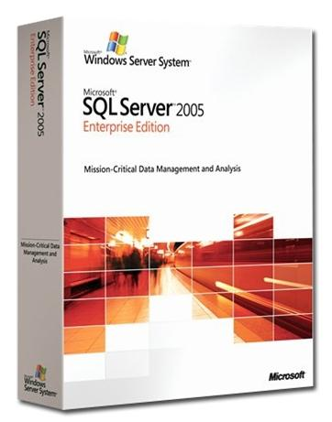
SQL
I'M SO OVER IT

Slide 24
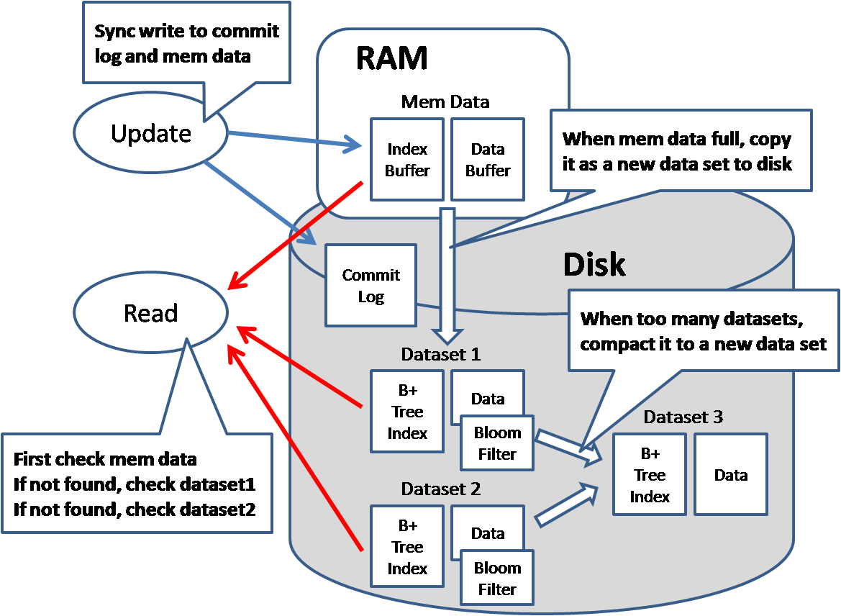
NOSQL
THE NO IS FOR “NO GIRLS”

Slide 25
THE NO
IS FOR “NO GIRLS”

Slide 26

BROSQL
IS TOTALLY CHILL

Slide 27
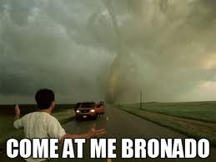
MESSAGING IS BETTER
WITH PYTHON

Slide 28

THIS DUDE
CAN RAGE

Slide 29
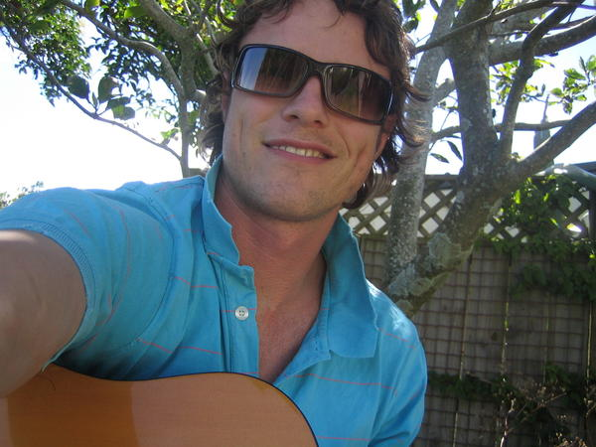
SICK BRO
IS SICK

Slide 30
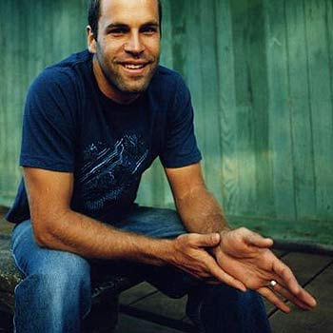
BORING BRO
IS BORING

Slide 31

STACHE BRO
IS STASHTASTIC

Slide 32
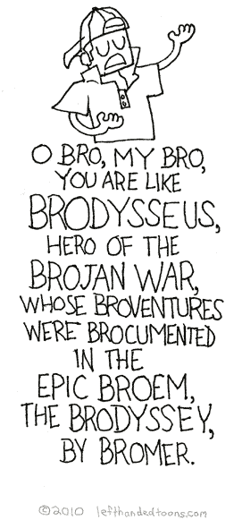
CLASSICAL
MAKES BETTER CODE

Slide 33
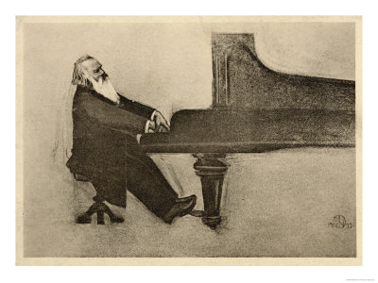
CLASSICAL
MAKES BETTER CODE

Slide 34
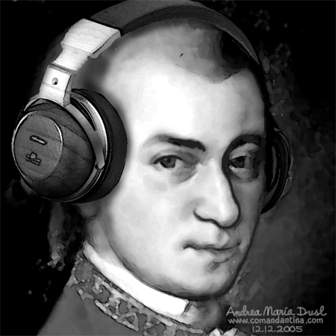
CLASSICAL
MAKES BETTER CODE

Slide 35

CLASSICAL
MAKES BETTER CODE

Slide 36
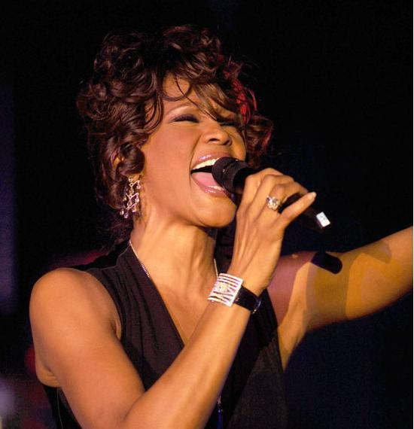
WHAT,
BRO?

Slide 37
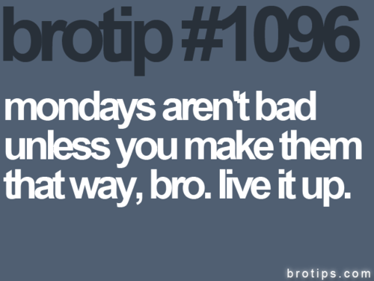
LIVE IT UP
24/7

Slide 38
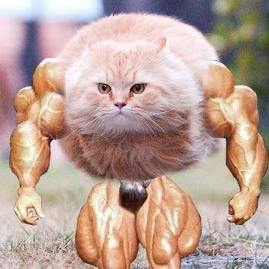
LIVE IT UP
AT THE GYM

Slide 39

FITNESS BALLS
ARE WEAK BALLS

Slide 40
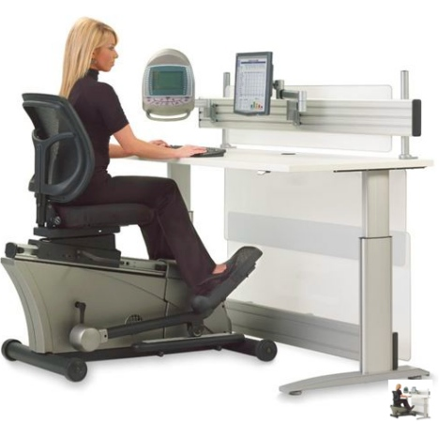
BRING THE GYM
TO THE OFFICE

Slide 41
BRING THE GYM
TO THE OFFICE

Slide 42
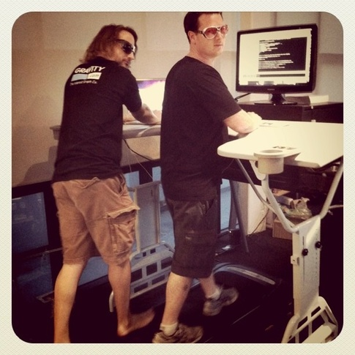
BRING THE GYM
TO THE OFFICE

Slide 43
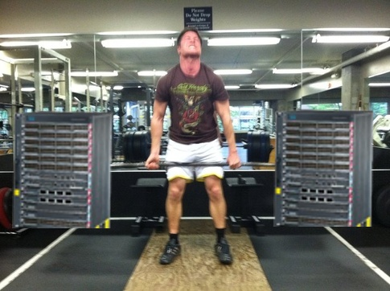
BRING THE GYM
TO THE DATACENTER

Slide 44
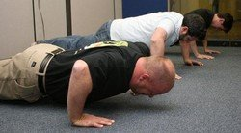
BRING THE GYM
TO MEETINGS

Slide 45
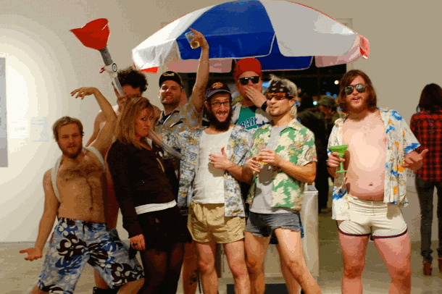
LIVE IT UP
AT THE PARTY

Slide 46
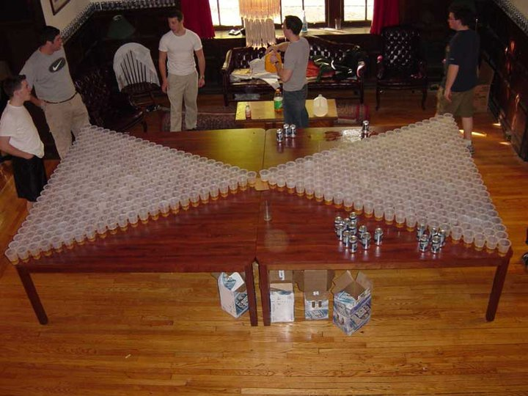
GO BIG OR
GO TO YOUR MOM

Slide 47
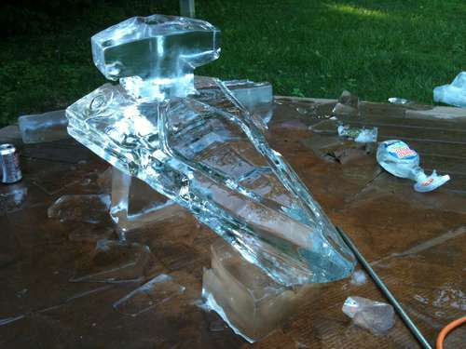
I FIND YOUR LACK OF FAITH
DISTURBING

Slide 48
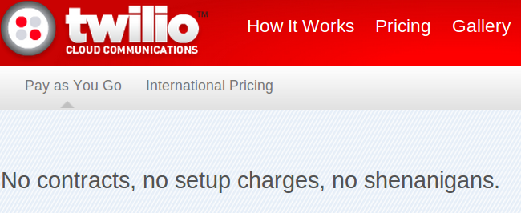
THE HARDEST CORE
DRINKING GAME

Slide 49
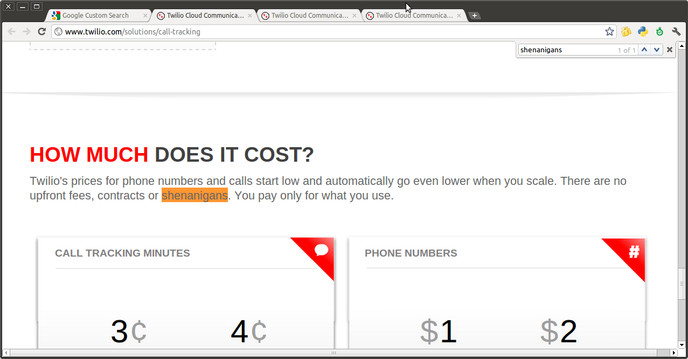
THE HARDEST CORE
DRINKING GAME

Slide 50
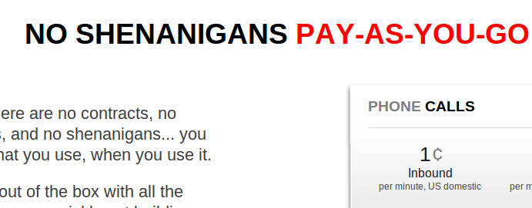
THE HARDEST CORE
DRINKING GAME

Slide 51
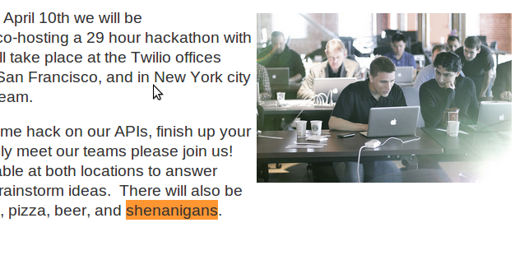
THE HARDEST CORE
DRINKING GAME

Slide 52
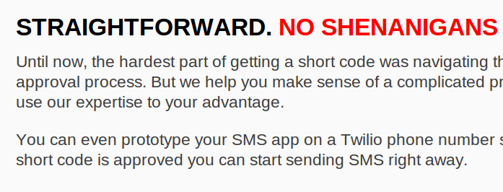
THE HARDEST CORE
DRINKING GAME

Slide 53
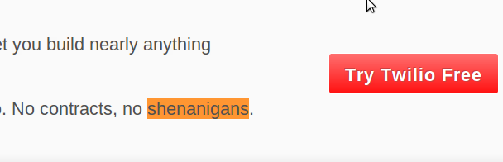
THE HARDEST CORE
DRINKING GAME

Slide 54

THE HARDEST CORE
DRINKING GAME

Slide 55
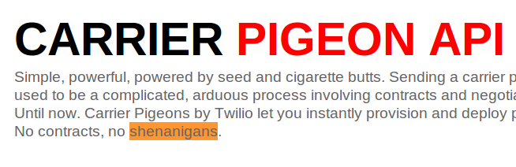
THE HARDEST CORE
DRINKING GAME

Slide 56
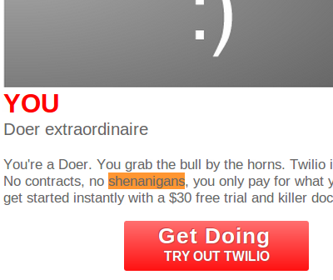
THE HARDEST CORE
DRINKING GAME

Slide 57
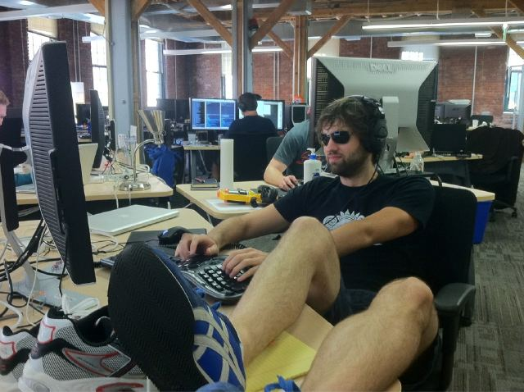
CONFORM TO THE
BROTOCOL

Slide 58

GTL EVERYDAY
BRO

Slide 59
GITHUB.COM/RobSpectre/Talks
@dN0t
RSPECTRE @TWILIO.COM
BROOKLYNHACKER.COM

Slide 60
THANK
YOU!

